Slide 1
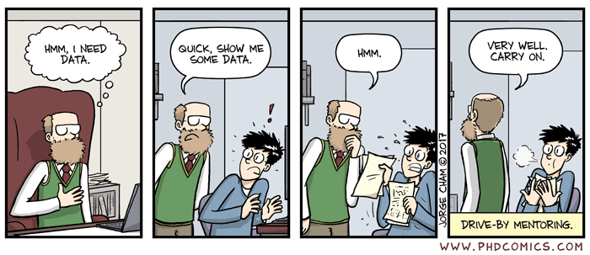
Data Science for Human Factors
Marius Klug
Biological Psychology and Neuroergonomics
Institute for Psychology and Ergonomics
Berlin Institute of Technology

Slide 2
Organisation

Slide 3
ISIS
You form teams of 2 there
You will also hand in assignments in ISIS and receive solutions automatically
Forum for Coding Questions (help each other out!)

Slide 4
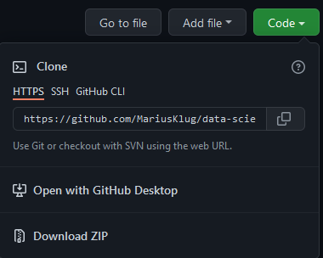
Github
https://github.com/MariusKlug/data-science
You will find all slides and code there
You will also find all assignments there
Clone to your PC or just download the zip file
It is possible that the repository gets updated. In that case I will notify you via ISIS

Slide 5
General
What you need to know:
General understanding of math
What you don’t need to know:
Programming
What you will learn:
Programming with MATLAB, code structure, error messgaes, clean code, functions, visualization in 2D and 3D, principles of machine learning
What will it take:
Blood, Sweat, and Tears. 180 hours of hard work, one does not simply learn programming!
Seriously, this course will probably take more time and effort than other courses, you are warned now.

Slide 6
Topics
Introduction: GUI and basic calculations
Coding 1: Scripts, style, and variable classes
Coding 2: Control statements and loops
Visualization 1: Basics, subplots, get and set
Coding 3: Functions
Visualization 2: Descriptive plots
Coding 4: Basic input and output
Visualization 3: Distribution and 3D plots
Coding 5: Input and output specials – last lecture before holidays
Machine Learning 1: Introduction and dimension reduction
Machine Learning 2: Clustering
Machine Learning 3: Classification
Coding 6: Efficiency and debugging basics
Coding 7: Advanced functions and debugging

Slide 7
Topics
Introduction: GUI and basic calculations
Coding 1: Scripts, style, and variable classes
Coding 2: Control statements and loops
Visualization 1: Basics, subplots, get and set
Coding 3: Functions
Visualization 2: Descriptive plots
Coding 4: Basic input and output
Visualization 3: Distribution and 3D plots
Coding 5: Input and output specials – last lecture before holidays
Machine Learning 1: Introduction and dimension reduction
Machine Learning 2: Clustering
Machine Learning 3: Classification
Coding 6: Efficiency and debugging basics
Coding 7: Advanced functions and debugging

Slide 8

Not Topics
Statistics
Regression
Toolboxes like Tensorflow
Deep learning (artificial neural networks)
Text or language processing

Slide 9




Structure
Integrated Lecture, all online on Zoom!
Zoom Meeting ID will be on ISIS
Discussion of questions about previous topics
New slides with topic overview
Live coding with new concepts
Explanation of new assignment
Coding exercises as assignments for teams of 2 each week (14*4.5=63P)
Teams in ISIS
Filename: „assignment_<assignmentnumber>_team_<teamnr>.zip”
WRONG FILENAMES WILL BE IGNORED! (no joke)
No names as comments in the assignment, just team number!
Large assignment (alone!) at the end of the semester (40P)
Sign in for the course in QUISPOS!

Slide 10
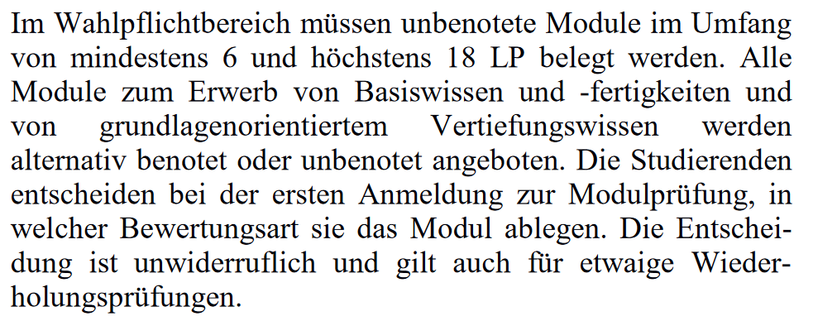
Grading
Either with or without grades (sign in in QUISPOS yourself!)
Without grades:
Pass/fail, each exercise will just be evaluated whether or not the code runs and produces the correct result
50% of the points needed for pass
With grades:
Code will also get points for partially correct exercises, actual feedback about the code will be provided

Slide 11
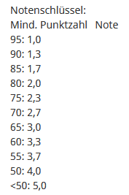
Grading
Either with or without grades
Sign in in QUISPOS yourself!
Find a partner with the same grading decision!
Tell me!
General
Pass/fail, each exercise will just be evaluated whether or not the code runs and produces the correct result
50% of the points needed to pass the class
This means 80% in weekly assignments is enough to pass without the final assignment
Special
Depending on the situation, code MIGHT also get points for partially correct exercises, and actual feedback about the code might be provided

Slide 12
MATLAB
TU Berlin offers MATLAB licences for free
https://de.mathworks.com/academia/tah-portal/tu-berlin-31461245.html
All my code runs on 2019b, so best get that version to avoid problems!
Toolboxes:
Statistics and Machine Learning
Signal Processing

Slide 13
Why MATLAB?
Easy to interact directly with data
Easy to learn, forgiving, high-level language
Errors won‘t directly make your PC blow up
Widely used in academia, also our lab
Comprehensive documentation and great debugging tools
Vast online resources (StackOverflow, FileExchange)
I know MATLAB best ;)
Skills are transferable anyways
Alternatives are e.g. Octave (very similar), R, Python, Julia, C++

Slide 14
Introduction
The GUI, MATLAB as a fancy claculator

Slide 15
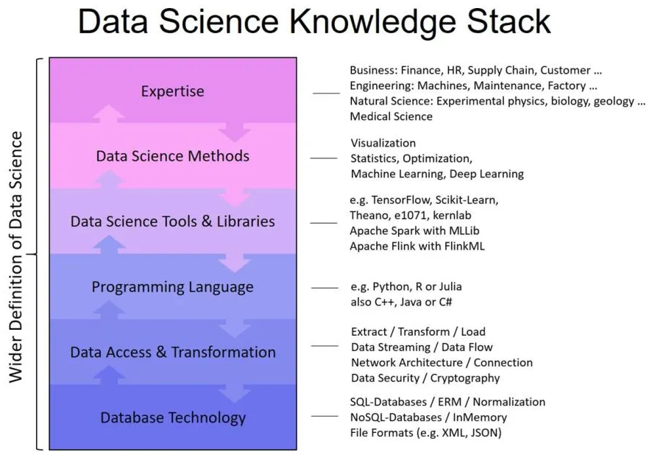
Data Science
Gain knowledge from data
Generate recommendations for actions
Visualize data
Data Mining more specifically about trends and patterns
Programming is essential
https://www.cio.de/a/was-ein-data-scientist-wirklich-koennen-muss,3577657

Slide 16
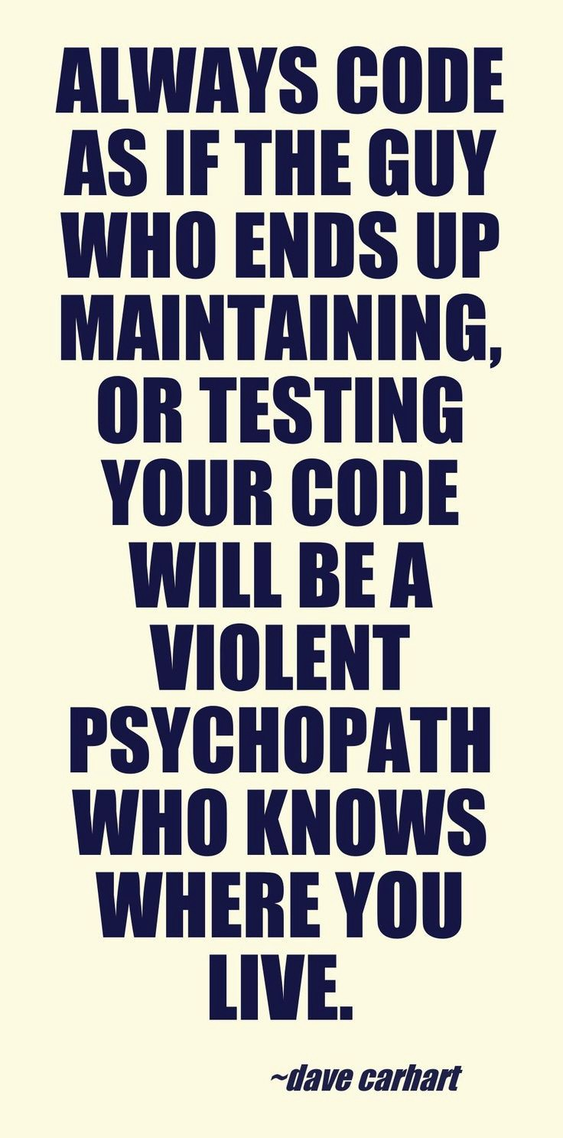

Become a programmer
Learn the words
Learn the grammar
Speak (Code)
Fail and learn
Learn to tolerate frustration
Don't use wireless mice.
Have some anger management.
Seriously.
I’m not joking.

Slide 17
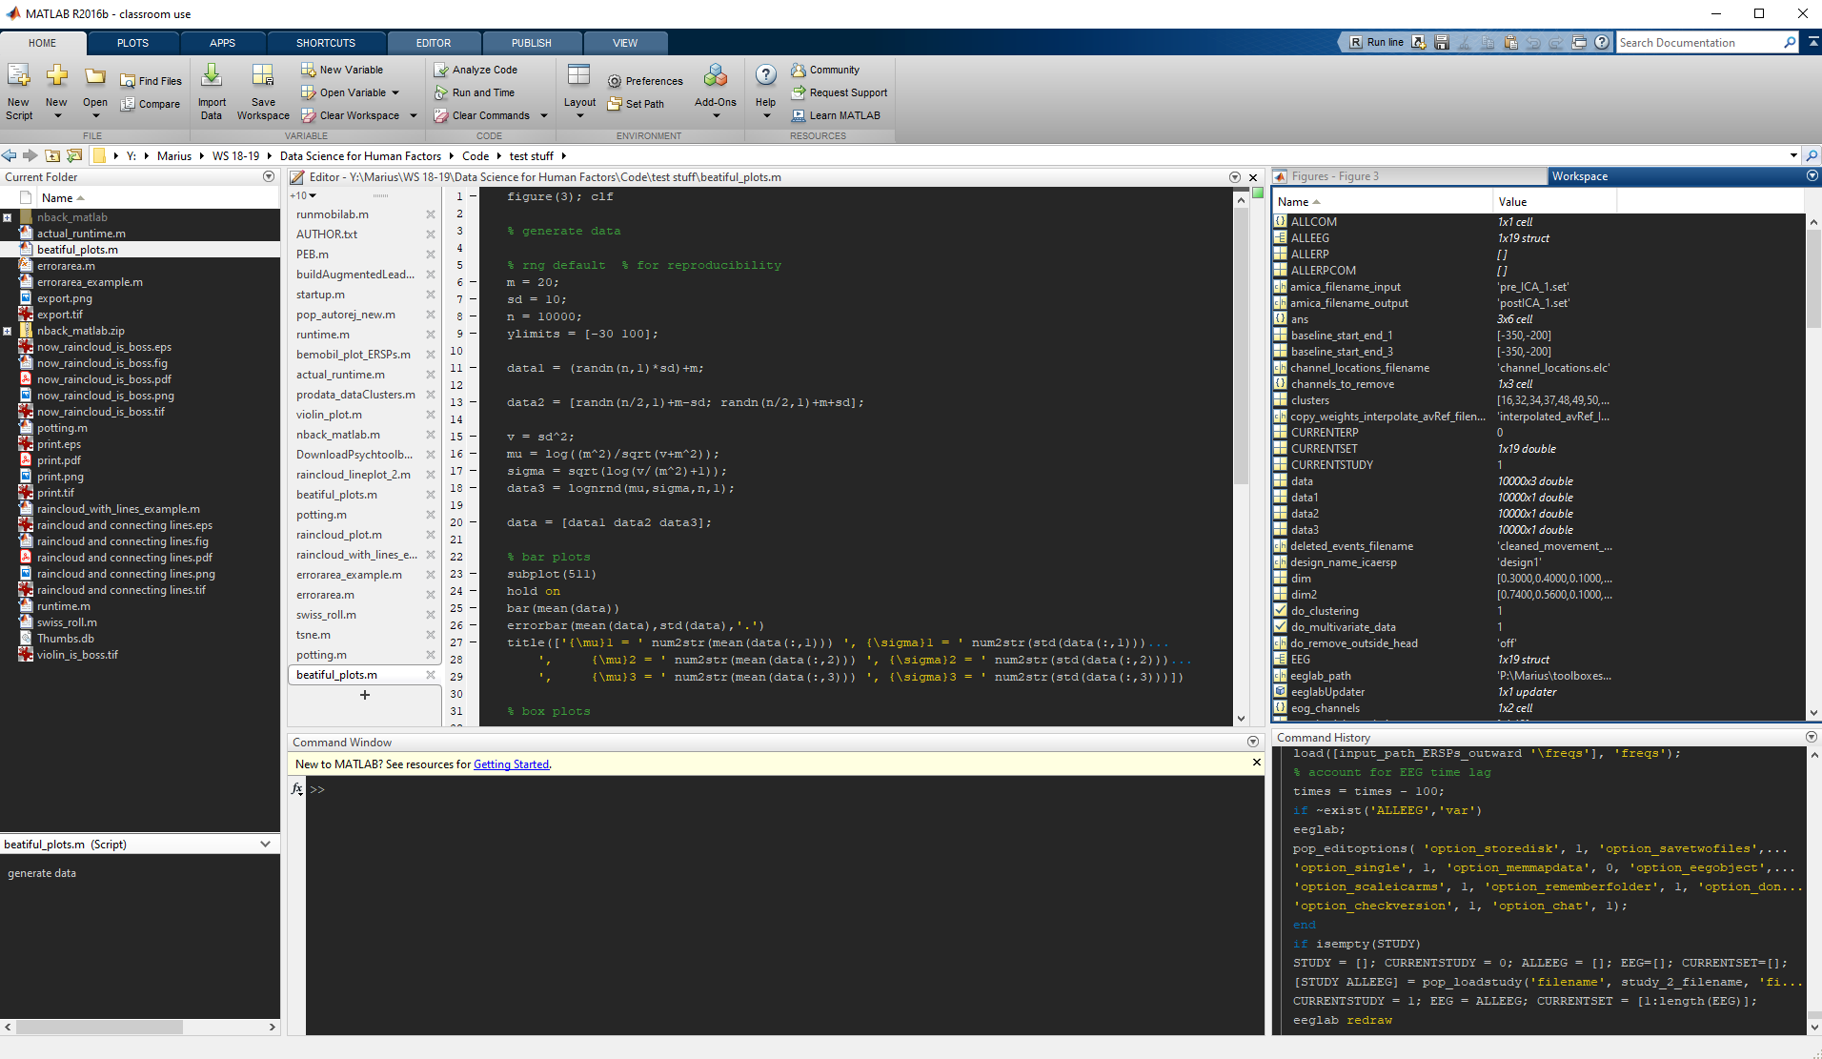
MATLAB

Slide 18
The MATLAB GUI
Command Window (execute stuff), Current Folder (find stuff), Editor (write stuff), Command History (old stuff), Workspace (data stuff), Inspector (guess…)
Dock&Undock, Drag&Drop
Preferences
Color Scheme, Font Size
Especially if you code at night.
Max column width
(Prefs -> Editor/Debugger -> Display AND Language)
"F1" for help, "CTRL-C" to cancel current operation

Slide 19
MATLAB as a fancy calculator
Use command window and „Enter“ to execute command
+ - * / ^
Parentheses for readability and order of operations
Colon (:) operator for skipping intervals
“Clc” to clear the command window

Slide 20
Variables
Default: ans
Storing data in the workspace ("x=1")
Reassign new values to old variables
Suppress output using semicolon (;)
Inspect in the workspace or by typing into the command window
Whos, clear (x, *, all)

Slide 21

Book Recommendation

